Slide 1
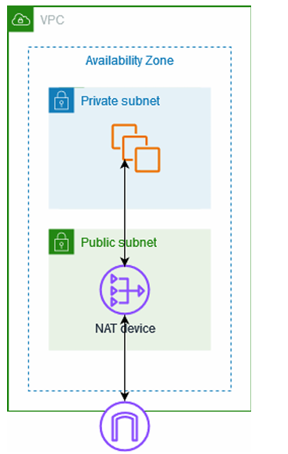
Sector : IT-ITes
NOS No : SSC/Q8112
Topic Name : VPC SET-UP
PMKK, VIJAYAWADA

Slide 2


What is Amazon VPC(Virtual Private Cloud)?
What is Amazon VPC(Virtual Private Cloud)?
What is VPC in simple Discourse:
Full form: Virtual Private Cloud
A logically isolated section of the AWS cloud.
You can define your own network (IP range, subnets, route tables, etc.)
What is VPC in simple Discourse:
Full form: Virtual Private Cloud
A logically isolated section of the AWS cloud.
You can define your own network (IP range, subnets, route tables, etc.)

Slide 3
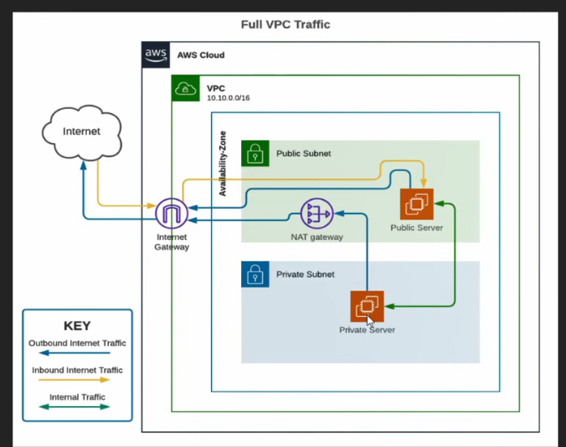
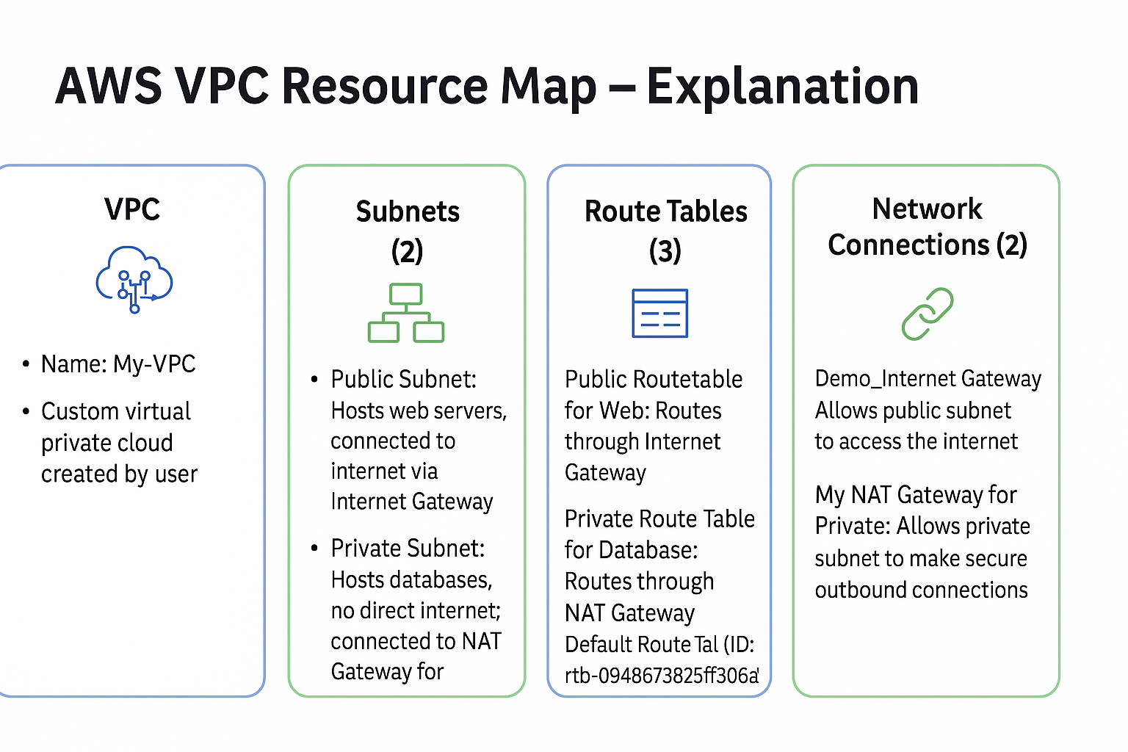
VPC Architecture Diagram

Slide 4
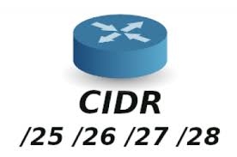
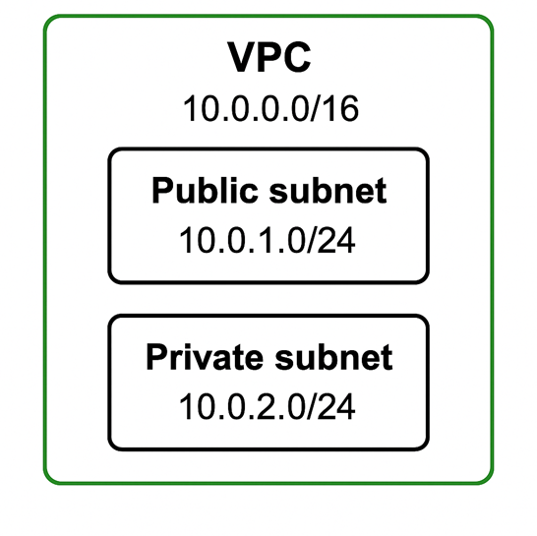
Classless Inter-Domain Routing (CIDR)
A technique for allocating IP addresses and for IP routing is called classless Inter-Domain Routing (CIDR), and its range is 0-32.
When setting up a VPC, we must specify a set of IPv4 Private addresses using classless Inter-Domain Routing (CIDR)
CIDR (Classless Inter-Domain Routing)CIDR is a way to represent IP address ranges using a format like this:
👉 Example: 10.0.0.0/16
10.0.0.0 → Starting IP address
/16 → How many bits are fixed for network (remaining for host)
When we create a VPC in AWS, we define a CIDR block:
👉 VPC CIDR Block: 10.0.0.0/16
This VPC can now be divided into smaller subnets.
Public Subnet: 10.0.1.0/24
Private Subnet: 10.0.2.0/24
📌 Each subnet can have its own security rules.

Slide 5
Subnets
To reduce traffic, the subnet will divide the big network into smaller, connected networks.
Imagine Your Full Colony (VPC):
10.0.0.0/16 ← Your entire land (VPC)
This gives you 65,536 IP addresses to use (a big area).
Term | Simple Meaning
10.0.0.0/16 | Main VPC range
/16 | Big network (65,536 IPs)
10.0.1.0/24 | Public subnet
10.0.2.0/24 | Private subnet
/24 | Small subnet (256 IPs)
Now Divide into Plots (Subnets)
Subnet 1 (for public use, like shops):
10.0.1.0/24 → 256 IPs (like a small area)
Subnet 2 (for private use, like houses):
10.0.2.0/24 → 256 Ips
Each /24 subnet gives you 256 addresses (like 256 rooms).

Slide 6
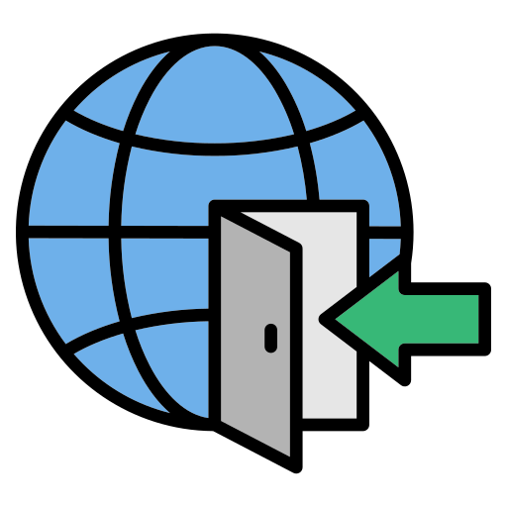
Internet Gateway
With the help of IGW (Internet Gateway), the resources present (e.g: EC2) in the VPC will enable to access the Internet.
One VPC can't have more than one IGW
If resources are running in a certain VPC then IGW can not be detached from that particular VPC

Slide 7

Route Tables
Route Table contains a set of rules, called route which helps us to route the network traffic.
A single VPC can have as many as route tables it requires.
If the dependencies are attached to the route table then they can't be deleted.

Slide 8
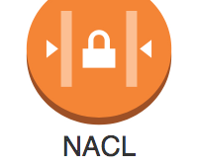
Network Access Control Lists (NACL)
VPC = Colony,
Subnets = Buildings,
NACL = Gate Guard Checks every incoming/outgoing packet
Has allow ✅ and deny ❌
rulesWorks at subnet level,
not instance level
Stateless: Must allow both inbound and outbound manually
Each VPC has a default NACL (can’t be deleted)You can create custom NACLs and assign them to subnets
Rules evaluated by number order (lowest to highest)

Slide 9
Security: Complete control over network.
Customization: Define own subnets, gateways.
Isolation: Dedicated cloud environment.
Connectivity: Integrate with on-premise data centers.
Why Use VPC?

Slide 10

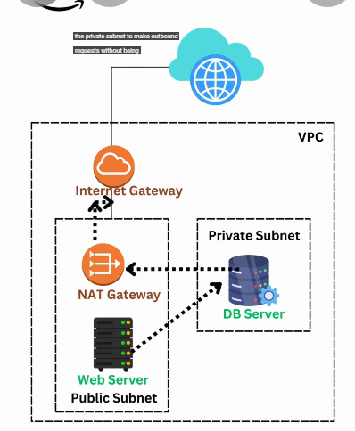
AWS VPC
Title: AWS VPC – Concept & Step-by-Step Practical

Slide 11
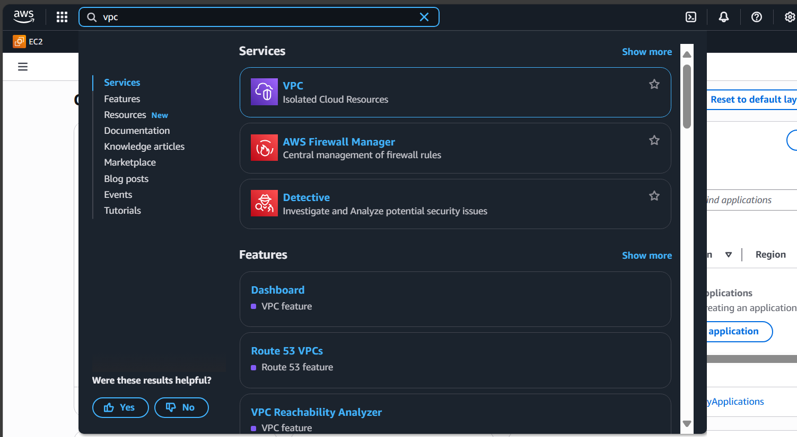
VPC
Practical Setup - Step 1
Create a VPC
Go to VPC Dashboard
Click "Create VPC"

Slide 12
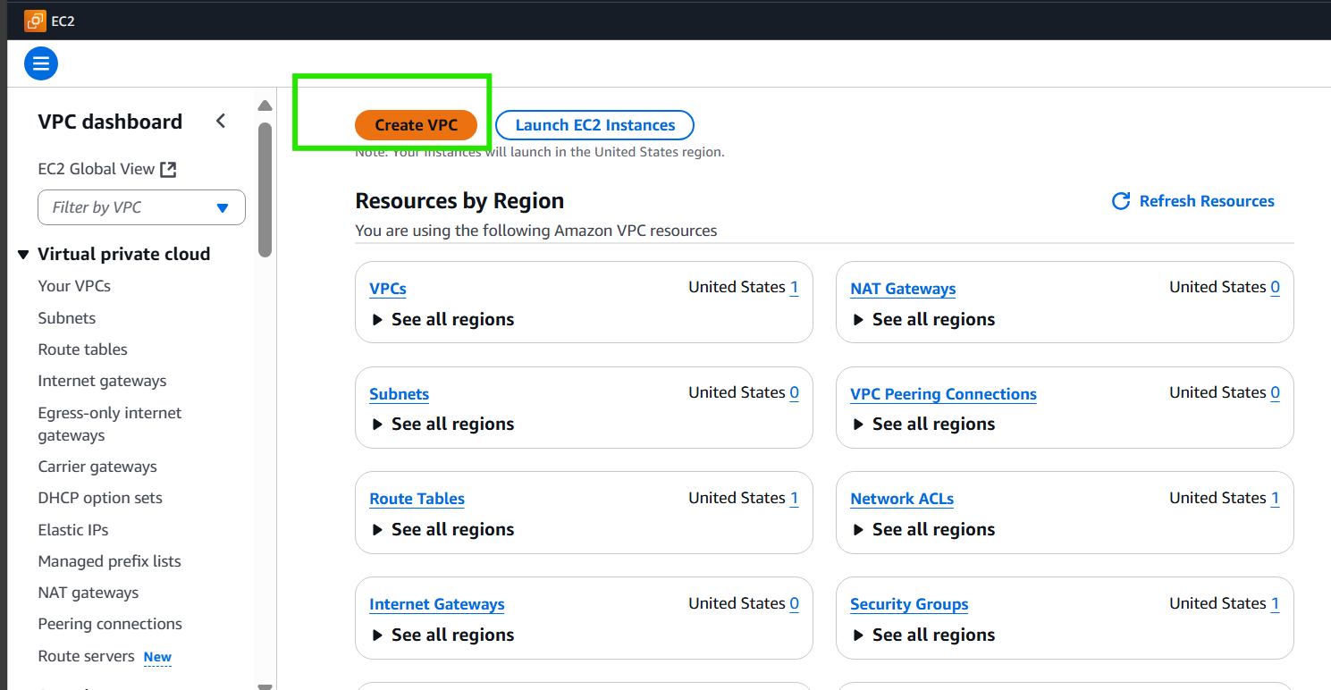
Click "Create VPC"

Slide 13
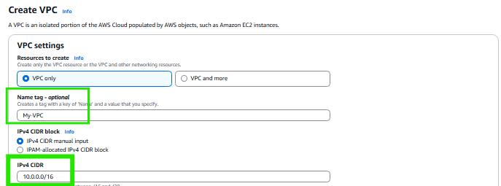
Name tag: My-VPC
CIDR: 10.0.0.0/16

Slide 14
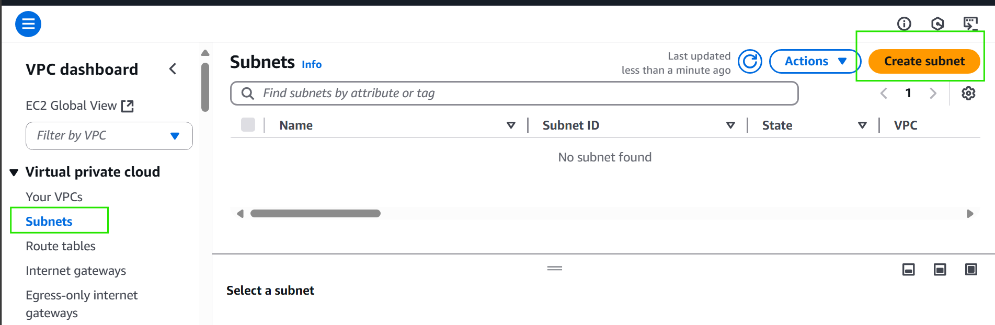
Step 2 - Create Subnets
Go to subnet tab press create subnet button

Slide 15
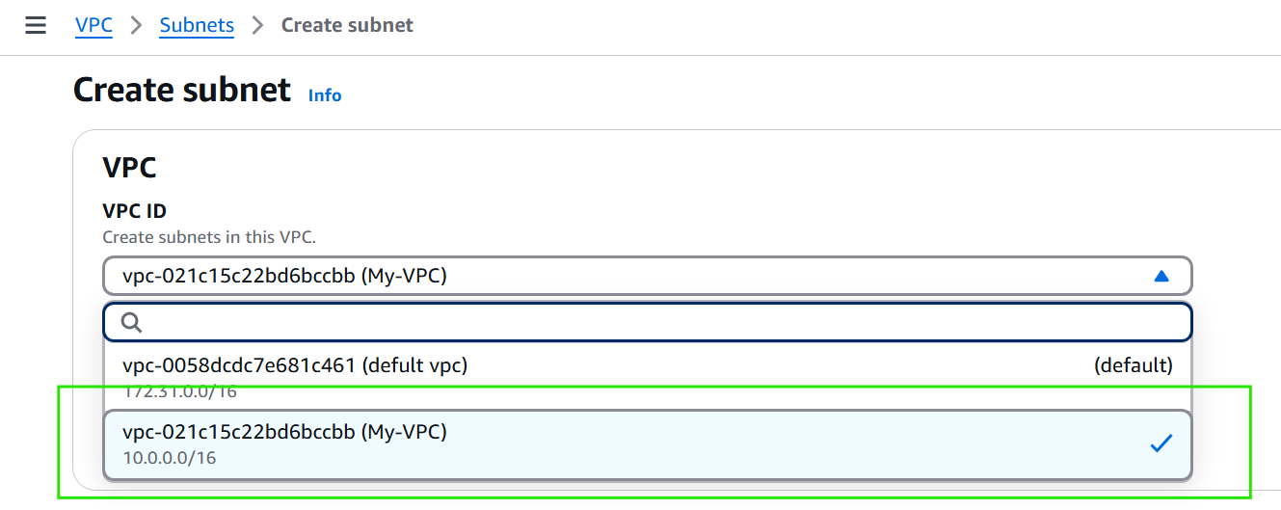
Step 2.1:
Selct VPC

Slide 16
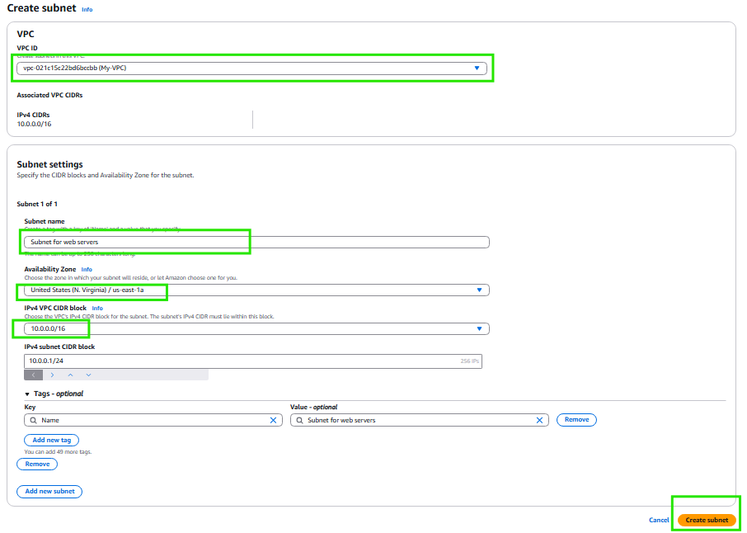
Step 2.2:
Create subnet for Public Subnet with CIDR 10.0.0.0/24 (e.g., for web servers)

Slide 17
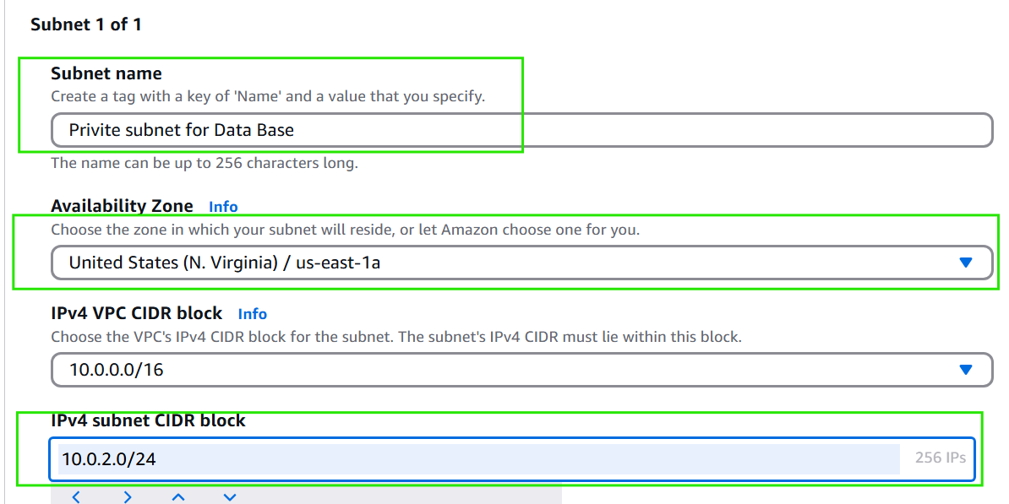
Step2.3:
Repeat the step2.2. now for create Private Subnet: 10.0.2.0/24 (e.g., for DB)

Slide 18
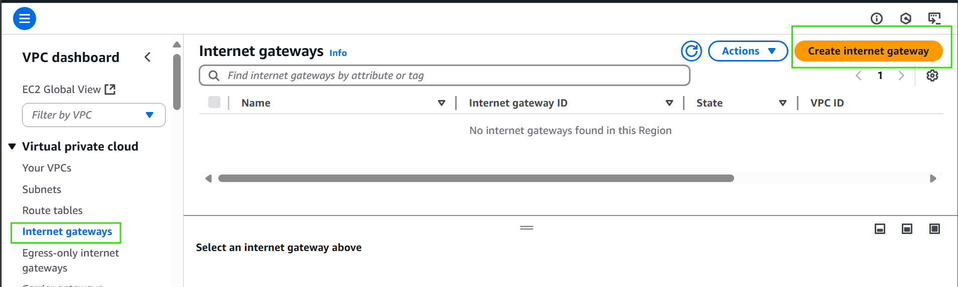
Step 3 - creat Internet Gateway
Go internet gatway tab
Select Create intent gateway button

Slide 19
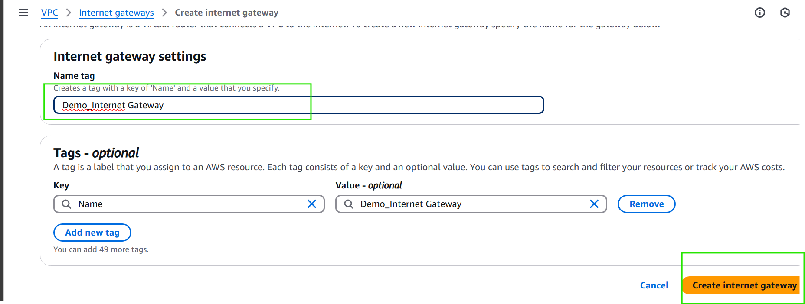
Step 3.1 - Attach Internet Gateway
Give Name tag to IGW(Internet gateway)

Slide 20
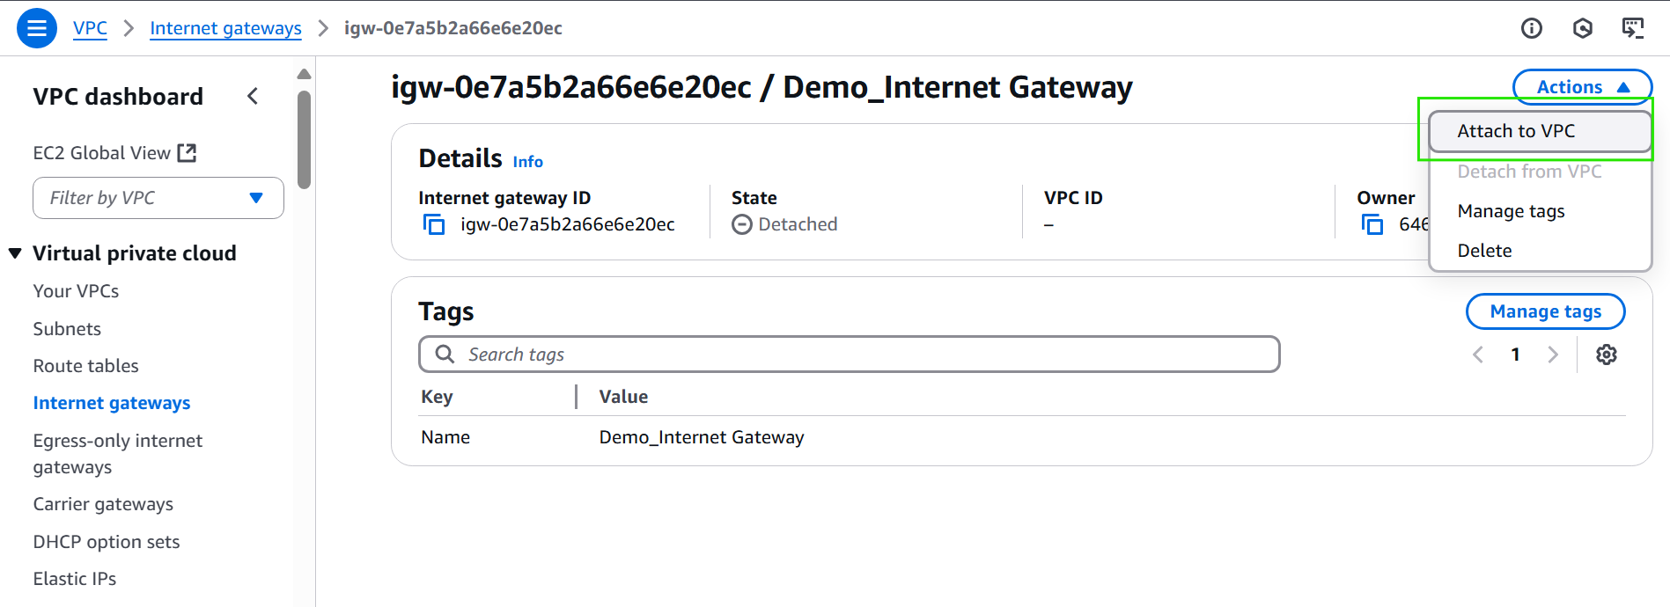
Step 3.2 - Attach Internet Gateway
Select action button and then
select Attach to VPC

Slide 21
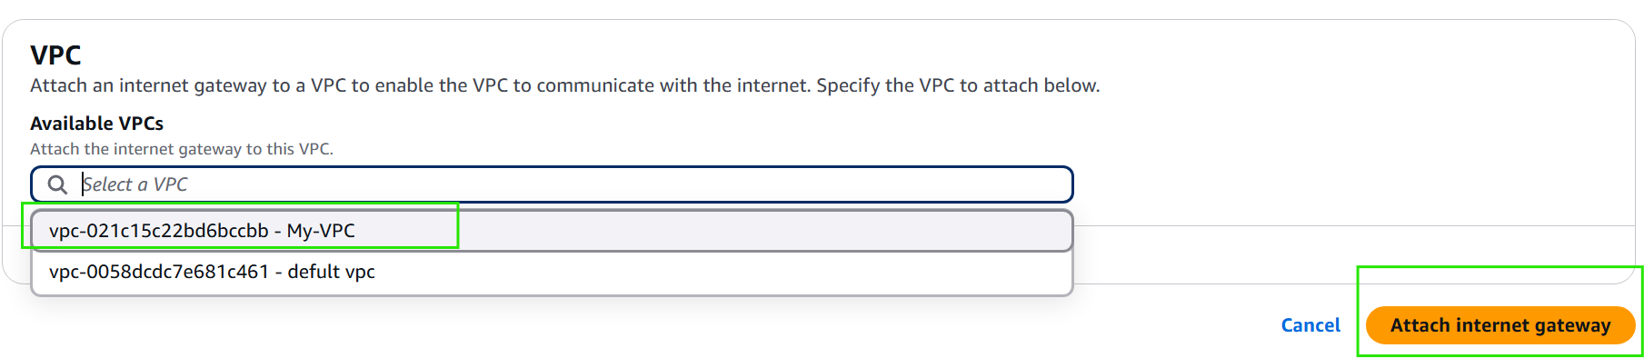
Step 3.3 - Attach Internet Gateway
Select VPC(My-VPC)
Select - Attach Internet Gateway

Slide 22
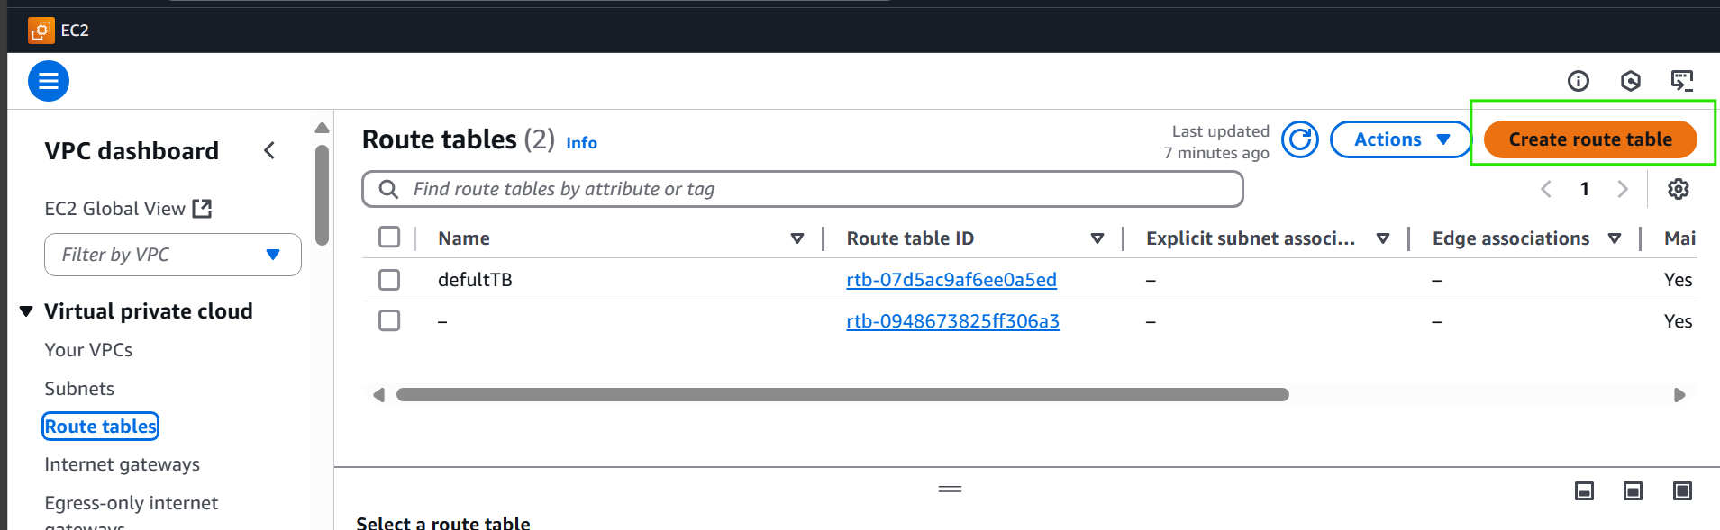
Step 4 - Setup Route Tables
Go to Subnet tab
Select Create subnet

Slide 23
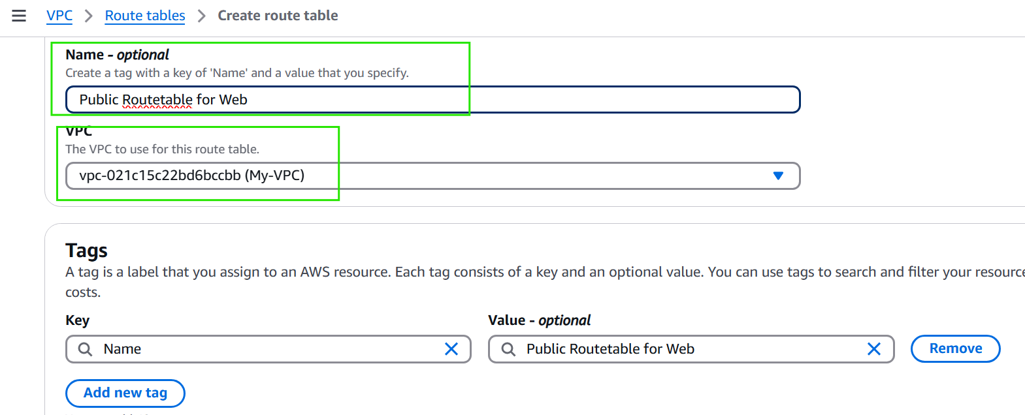
Step 4.1: Public Route Table:
Type Name Tag to identify example Public for Web
Then select VPCMy-VPC)
Select Create Route Table

Slide 24
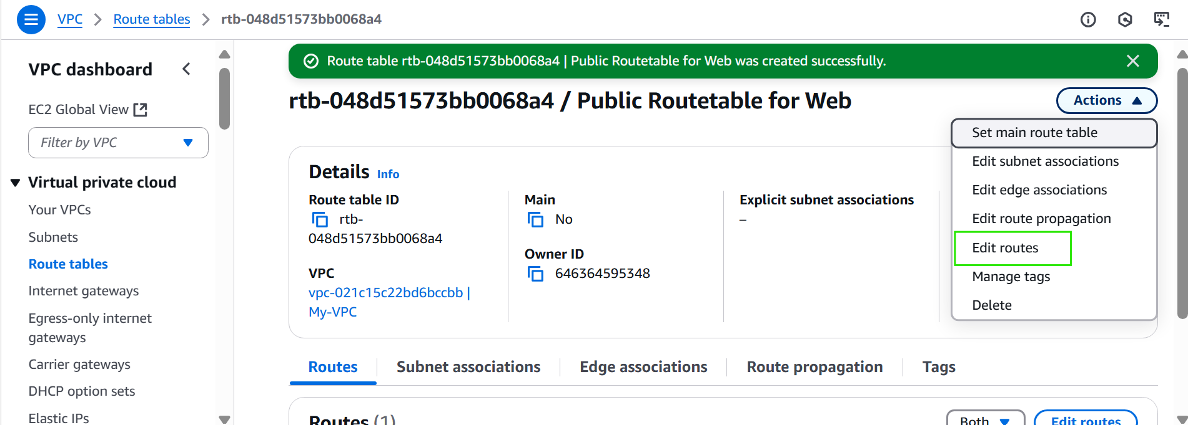
Step4.2: Edit routes of rtb-048d51573bb0068a4 / Public Routetable for web
Select “Action” tab
Select “Edit route”

Slide 25
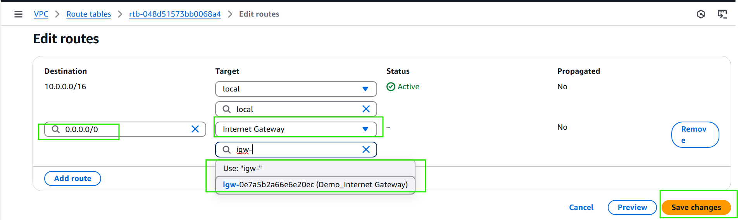
Click “Add routes” In Destination,
enter 0.0.0.0/0(Means: All internet traffic)In Target,
select Internet Gateway Choose the correct IGW ID from the dropdown (e.g., igw-0e7a5b...)
Click “Save changes” to apply the route

Slide 26
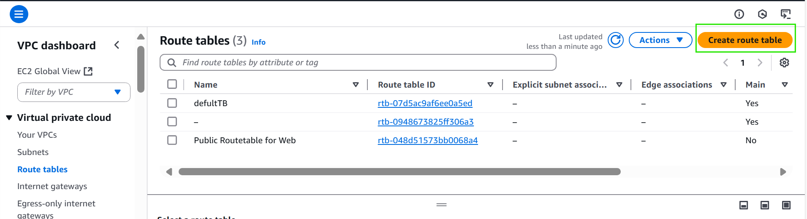
Step 4.4:
Create a Private Route Table in AWS VPC
Go to VPC > Route Tables
Click Create Route Table

Slide 27
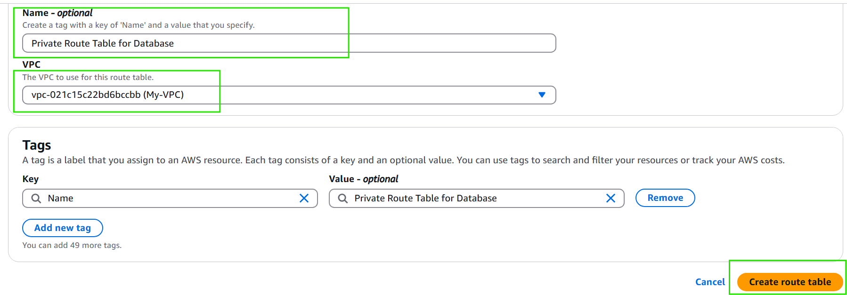
Enter a Name (e.g., Private Route Table for Database)
Select the VPC from the dropdown (e.g., My-VPC)
Add a Tag for easier management (Key: Name, Value: Private Route Table for Database)
Click “Create route table” to finish

Slide 28
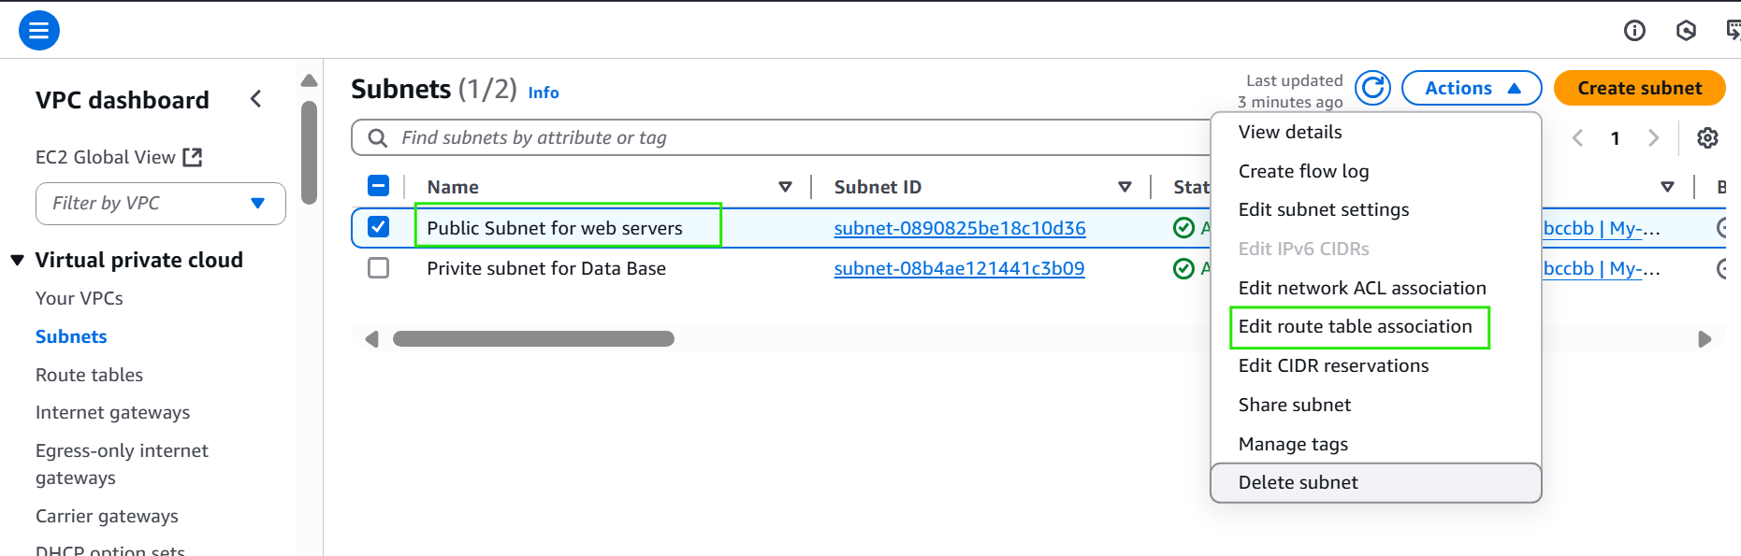
🌐 Associate a Subnet with a Route Table
Go to the VPC Dashboard > Subnets

Slide 29
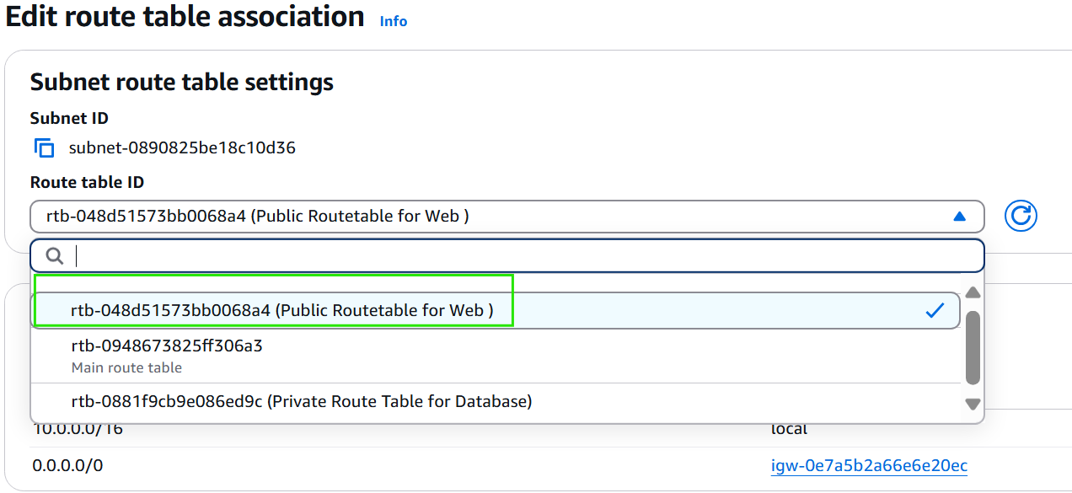
Select Route table ID
Select the subnet (e.g., Public Subnet for web servers)
Click the Actions dropdown (top-right)
Choose Edit route table association
This allows you to connect the subnet with the correct Route Table

Slide 30
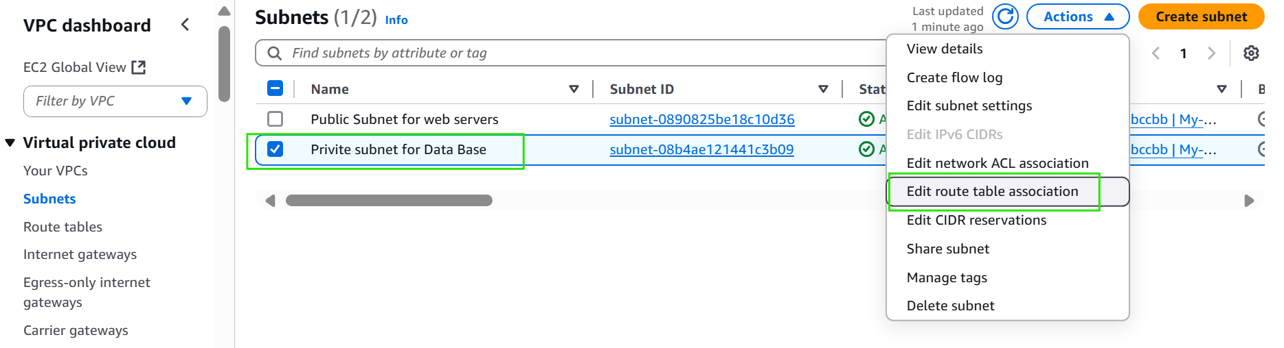
Select the subnet (e.g., Private Subnet for database servers)
Click the Actions dropdown (top-right)
Choose Edit route table association

Slide 31
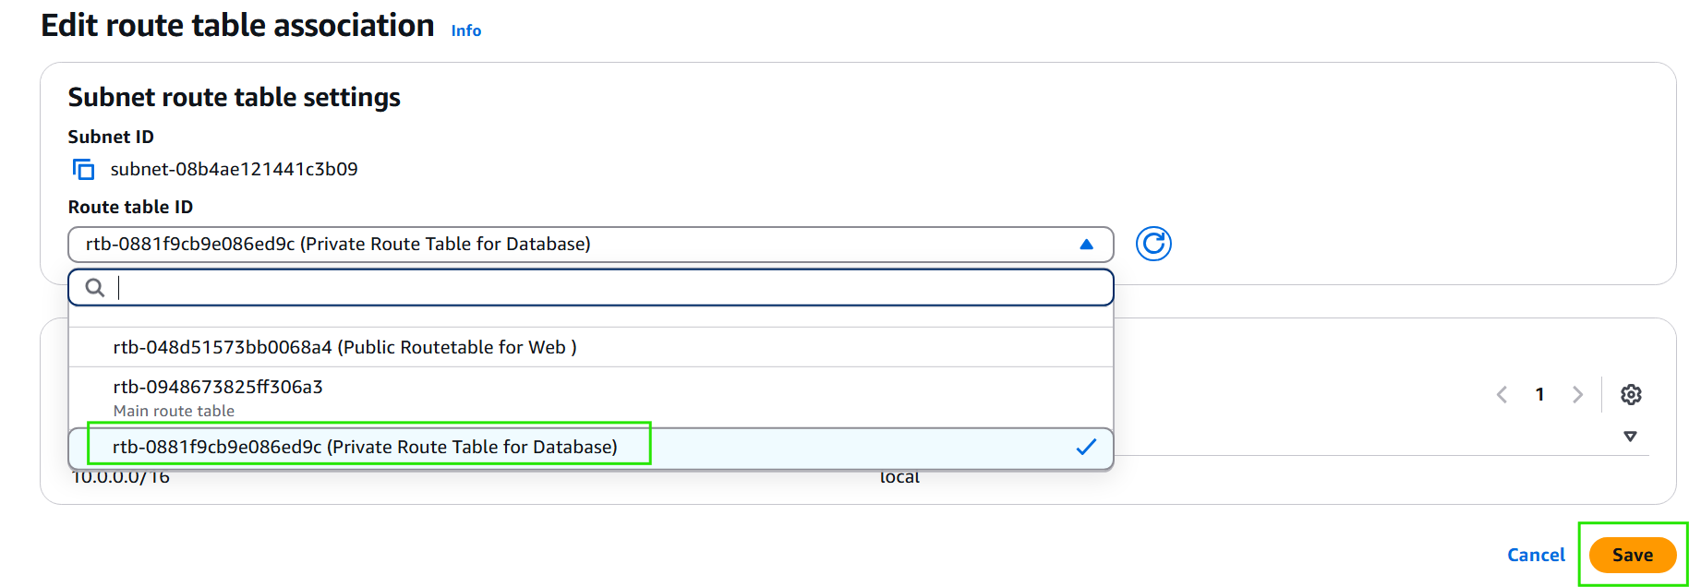
This allows you to connect the subnet with the correct Route Table

Slide 32
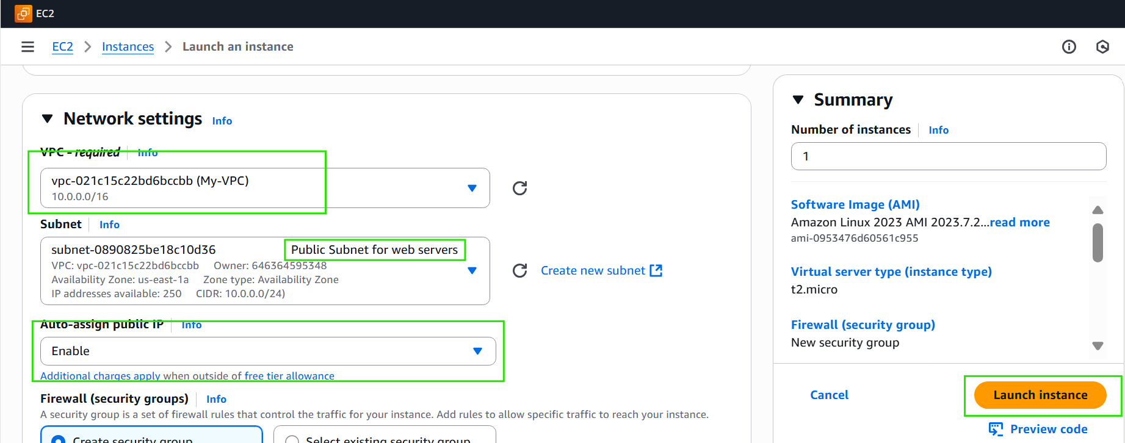
🚀 Launch EC2 Instance into Public Subnet
Go to EC2 > Launch Instance
Under Network Settings, choose:
VPC: Select your VPC (e.g., My-VPC)
Subnet: Choose Public Subnet for web servers
Auto-assign public IP: Set to Enable
Choose the desired AMI and instance type (e.g., Amazon Linux, t2.micro)
Configure security group (default or custom)
Click Launch instance

Slide 33
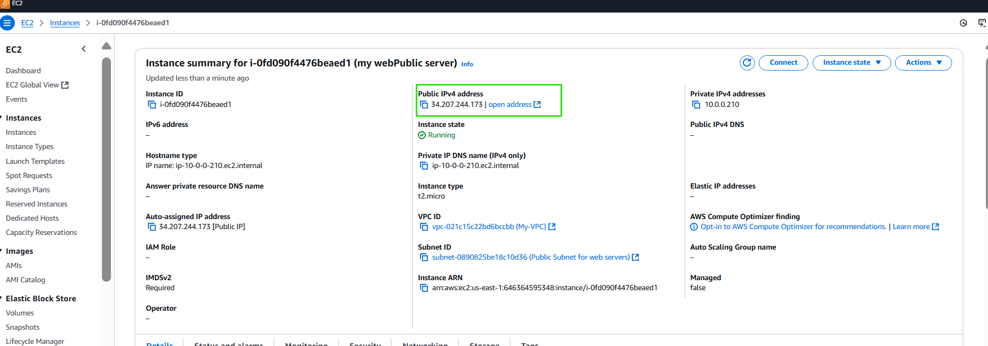
Observe that Public Ip assigned
Private IP created within CILD range

Slide 34
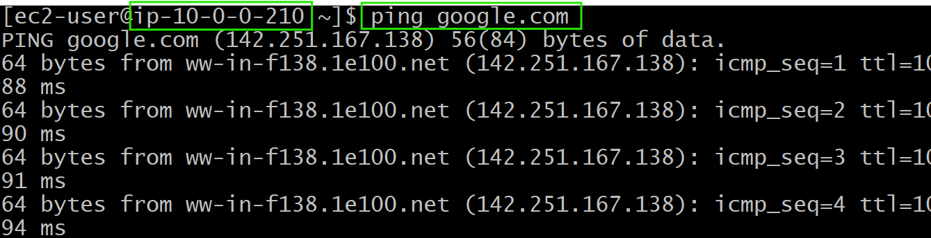
Login to instance
We can observe that private IP address
Test internet connection by testing google connection with ping.google.com

Slide 35
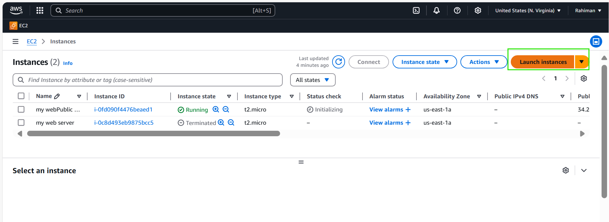
Step 8;
Luch praivite instance

Slide 36
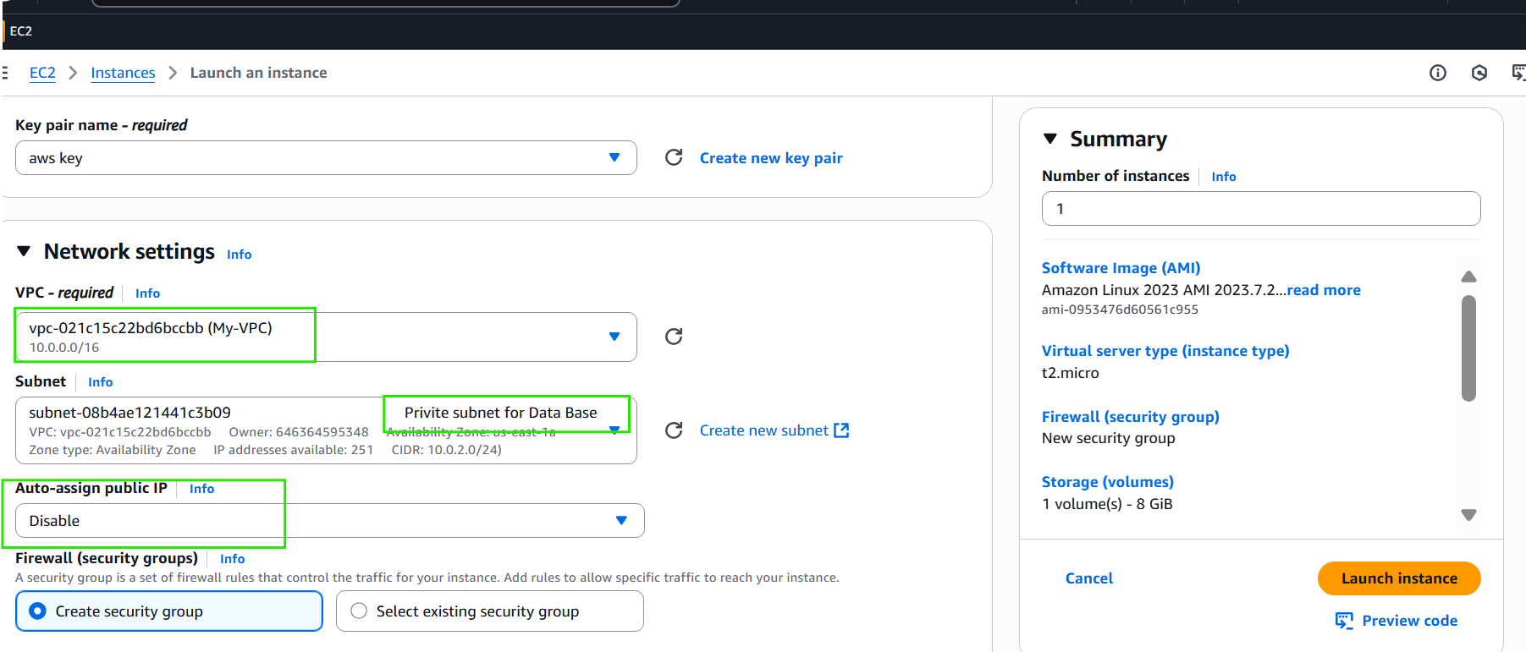
Select common VPC which is selected for public instance
Select Private subnet
Disable Auto assign Public IP
Lunch instance

Slide 37
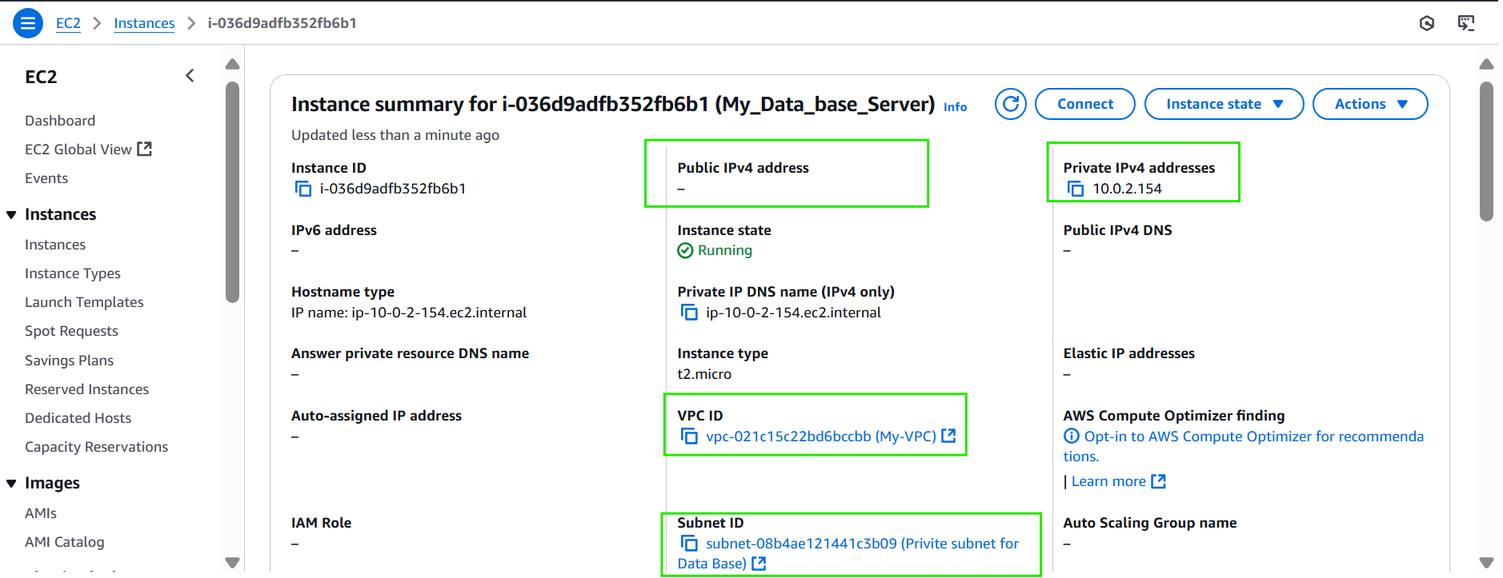
We can observe that no public address is assigned the instance is sequred

Slide 38
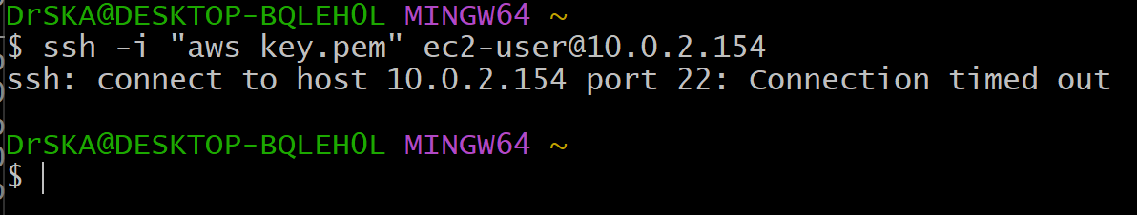
Try login in Private instance
We can obseve that not possible to login
Due to Sequred with in VPC

Slide 39
Send .pem key to Public instance from local mechine
For example : send notes.txt file
scp -i /path/aws-key.pem notes.txt ec2-user@34.207.244.173:/path

Slide 40
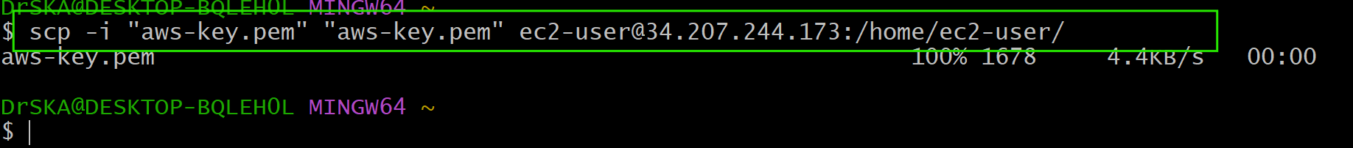
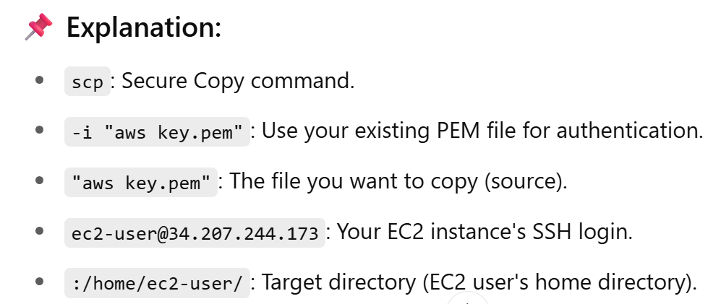
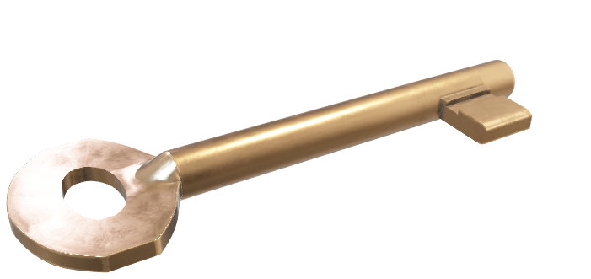

Slide 41
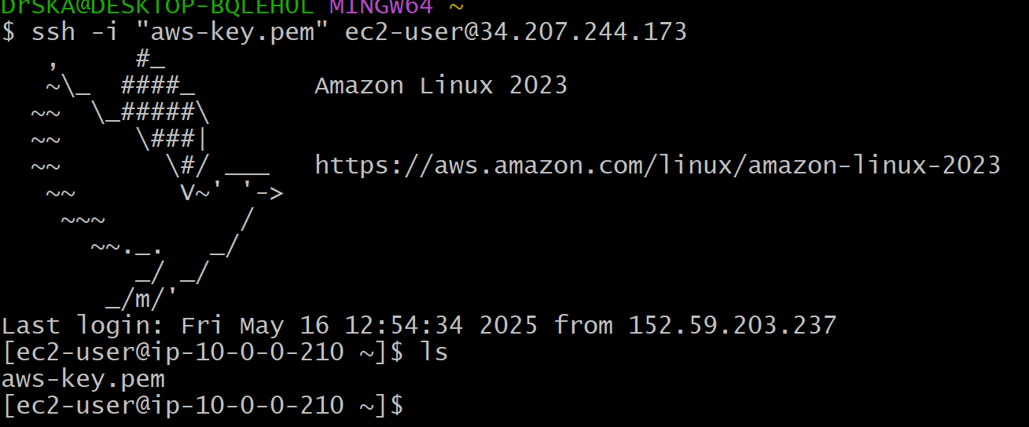
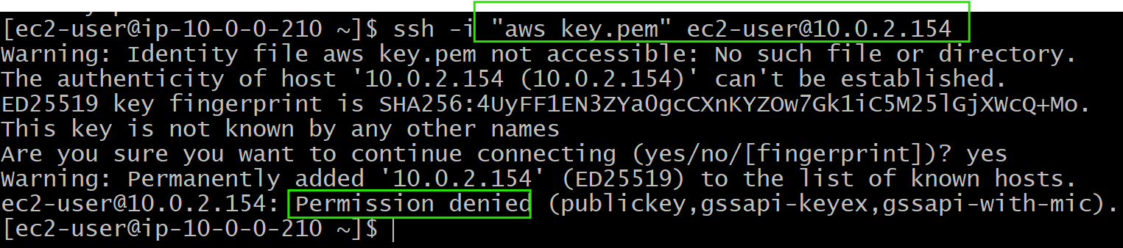
Check the .pem key receive
Try login Private instance with in Public instance
We can observe that
permission denied due to Private instance sequred no public IP address assin
And need to change .pem key permission

Slide 42
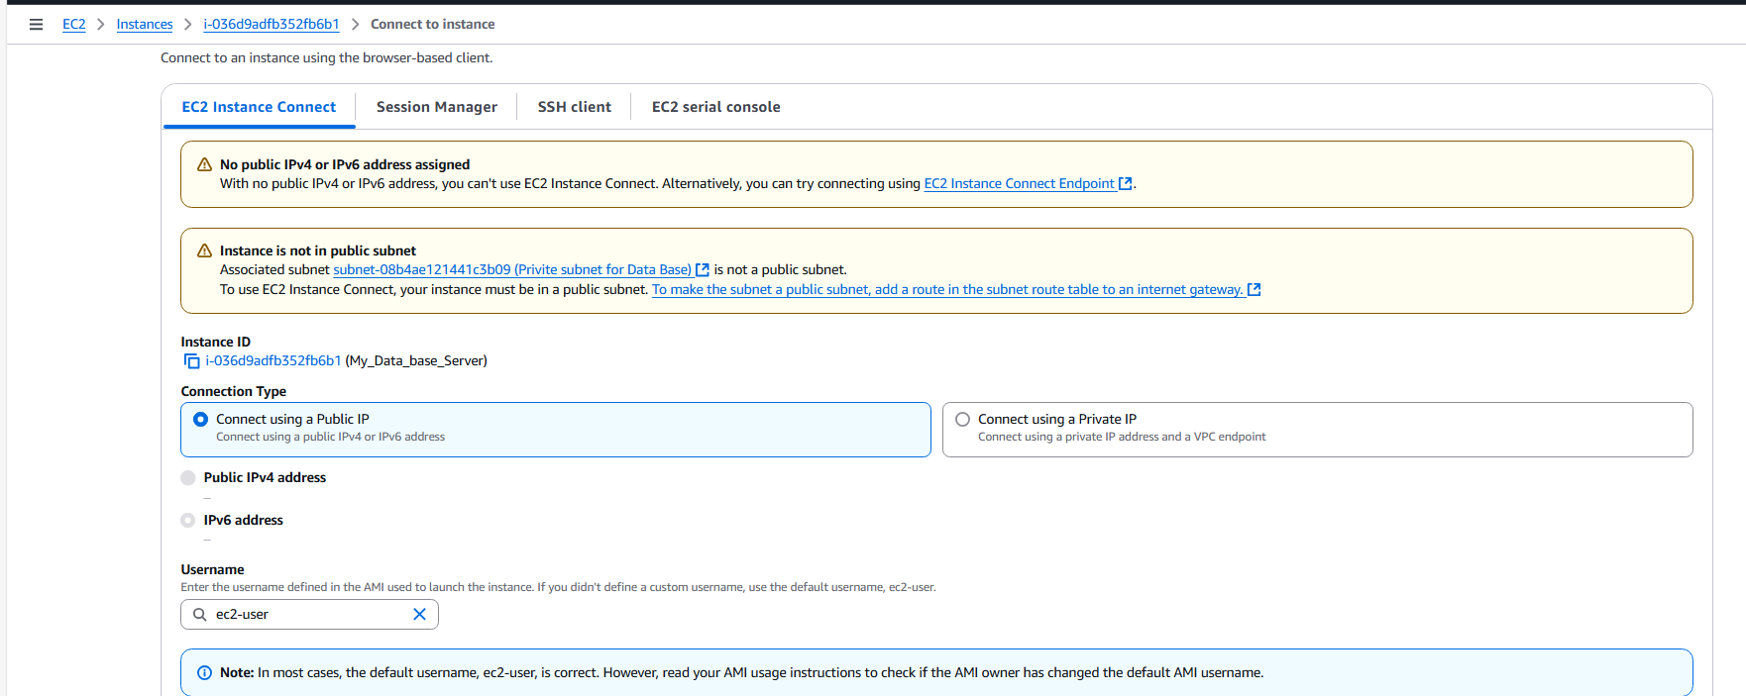
We also check status in EC2 instance Connect Tab

